Slide 1
Raspberry Camera

Slide 2
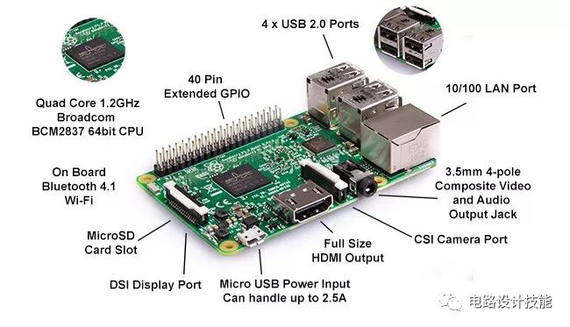
Interface

Slide 3
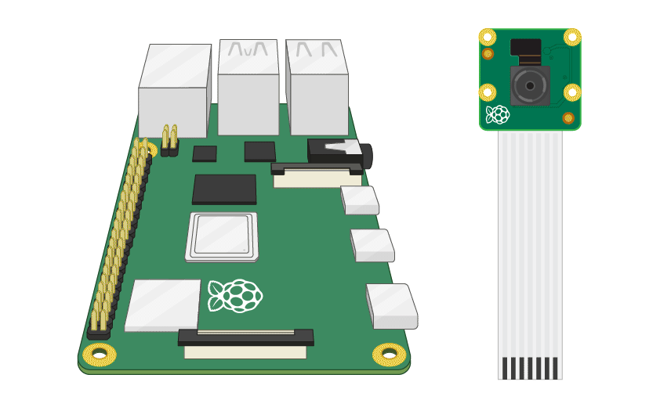
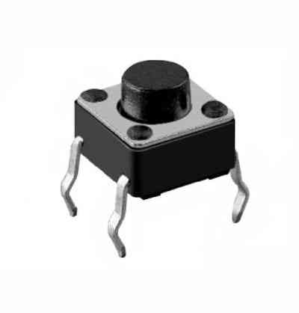
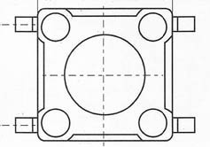
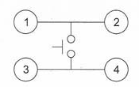
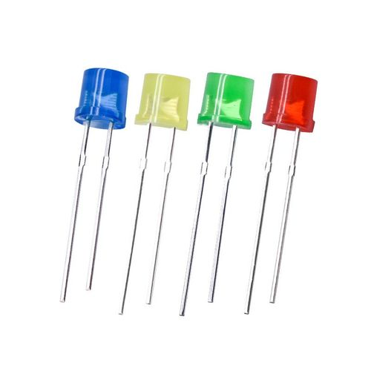
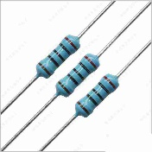
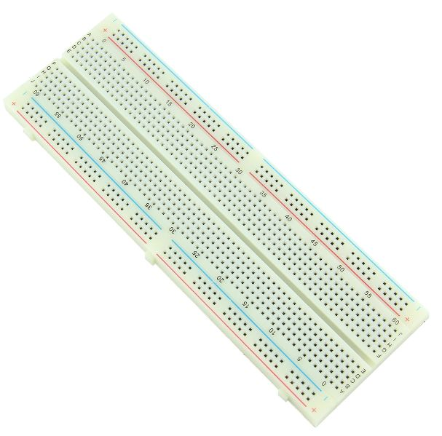
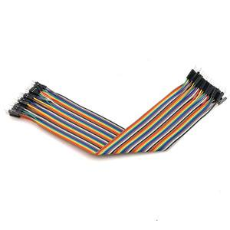
Camera
from time import sleep
import os
import subprocess
from picamera2 import Picamera2
# preview setting
os.environ['DISPLAY'] = ':0'
subprocess.run([‘libcamera-hello’,‘--width’,‘640’,‘--height’,‘480’,'-t','5000'])
# camera setting
With Picamera2() as picam2:
preview_config = picam2.create_preview_configuration(main={“size”: (640, 480)})
still_config = picam2.create_still_configuration(main={“size”: (640, 480)})
picam2.configure(preview_config)
picam2.start()
picam2.switch_mode_and_capture_file(still_config, filepath)
picam2.switch_mode(preview_config)
# GPIO edge detect:
# state: GPIO.RISING/GPIO.FAlLING/GPIO.BOTH
GPIO.wait_for_edge(channel, state)
Notes:
按键开关，长的两端是相连的
https://www.elecfans.com/yuanqijian/kaiguan/201912271145249.html

Slide 4
The output voltage of GPIO pins is 3.3V.
The resistance of the LED can‘t be ignored.
Voltage higher than 2V can be detected by GPIO pins as input.
Circuit

